Slide 1





Listening to the Universe with LIGO
An Introduction the
Laser Interferometer Gravitational-wave Observatory
and
The beginning of Gravitational Wave Astronomy
Eric Myers
April 2016

Slide 2
Summary
LIGO is was a cutting-edge physics experiment which is was attempting to detect gravitational waves, and thereby test Einstein's general theory of relativity for dynamical fields.
Detection of gravitational waves will open up an entirely new branch of astronomy!
LIGO is the most sensitive optical device on the planet.
The computational effort required to perform an “all-sky blind” search for the signal of a Continuous Wave source (like a neutron star) is so large that it requires a supercomputer (such as Einstein@Home)
LIGO has recently detected gravitational waves from the inspiral and merger of two large black holes!

Slide 3
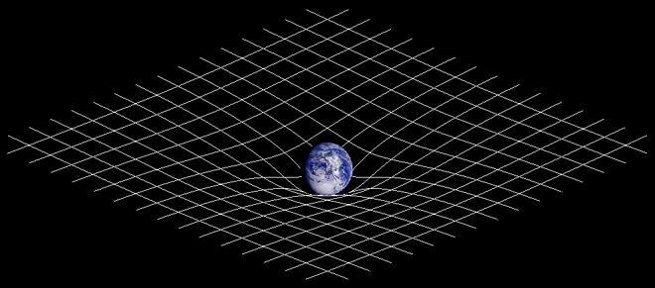
What are Gravitational Waves?
Astronomy now is done via Electromagnetic Waves (radio, infrared, visible, ultraviolet, gamma rays).
These are time-varying oscillations of electro-magnetic fields.
Gravitational Waves are time-varying oscillations of the gravitational field.
In General Relativity gravitation is described as being a property of the geometry of space + time = spacetime
Two Principles:
Matter curves spacetime,
and
Objects in “free-fall”
travel in “straight”
paths in the curved space.

Slide 4
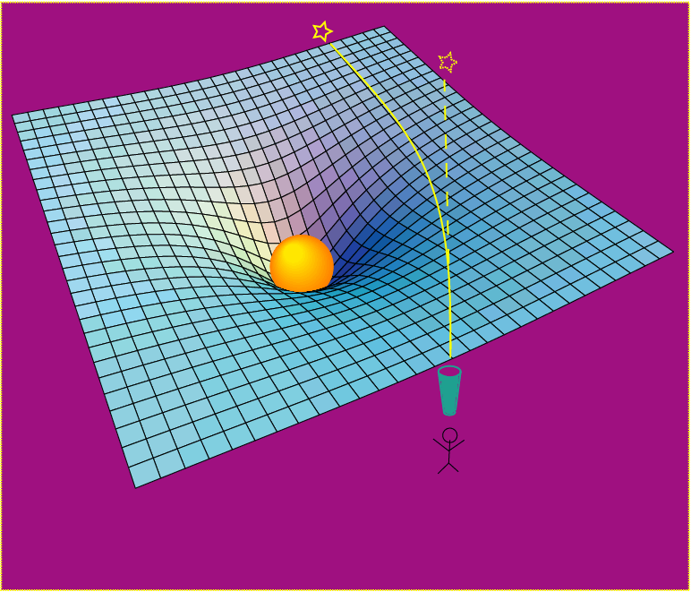
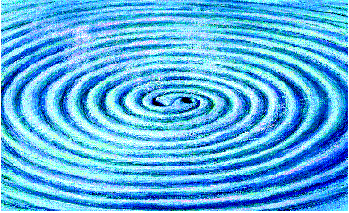
Gravitational Waves as curvature of space-time
Rendering of space-time stirred by
two orbiting black holes
Matter curves space-time, and objects
in “free-fall” (even photons) travel in “straight” paths in the curved space.
Changes in space-time produced by moving a mass are not felt instantaneously everywhere in space, but propagate out as waves

Slide 5
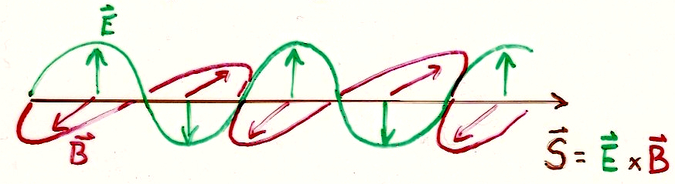
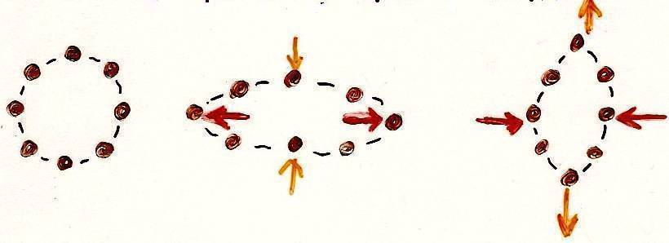
Comparison with EM waves
Electromagnetic Waves
Travel at the speed of light
“transverse”
Vector - dipole in both E and B
Two polarizations: horizontal and vertical
Gravitational Waves
Travel at the speed of light
“transverse”
Tensor - quadrupole distortions of space-time
Two polarizations, “+” and “x”
Solutions to Maxwell’s Eqns.
EM waves can be generated by a changing dipole charge distribution.
Solutions to Einstein’s Eqns.
Gravitational waves require changing quadrupole mass distribution.

Slide 6
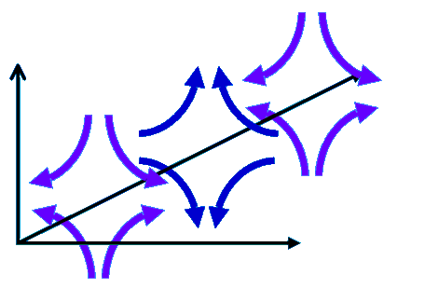
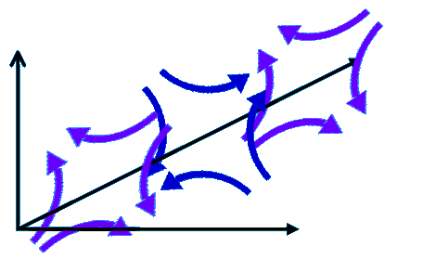
Comparison with EM waves
Electromagnetic Waves
Travel at the speed of light
“transverse”
Vector - dipole in both E and B
Two polarizations: horizontal and vertical
Gravitational Waves
Travel at the speed of light
“transverse”
Tensor - quadrupole distortions of space-time
Two polarizations, “+” and “x”
Solutions to Maxwell’s Eqns.
EM waves can be generated by a changing dipole charge distribution.
Solutions to Einstein’s Eqns.
Gravitational waves require changing quadrupole mass distribution.

Slide 7
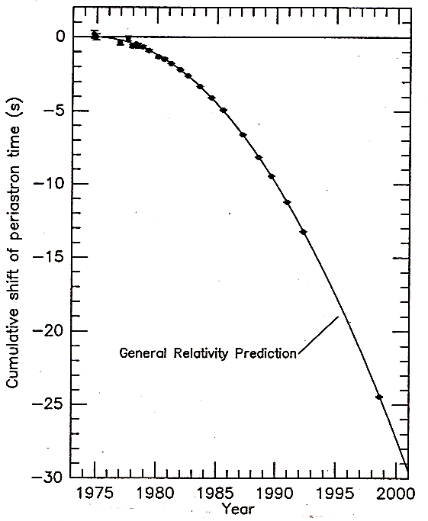
Indirect Evidence
Taylor and Hulse studied PSR1913+16 (two neutron stars, one a pulsar) and measured orbital parameters and how they changed.
The measured precession of the orbit exactly matches the expected loss of energy due to gravitational radiation.
17 / sec
•
17 / sec
•
~ 8 hr
•
(Nobel Prize in Physics, 1993)

Slide 8
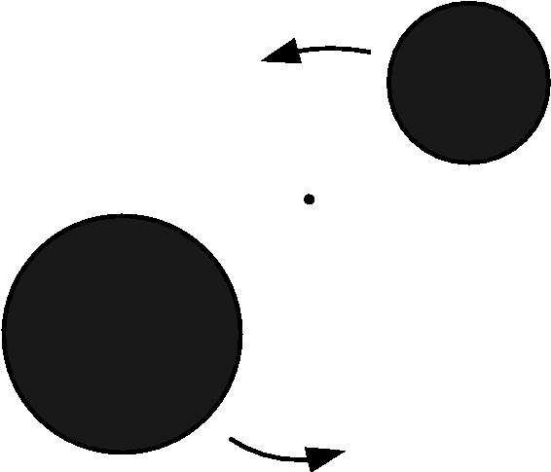
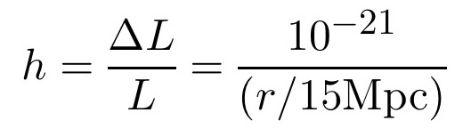
Example: Binary Inspiral
A pair of 1.4M☉ neutron stars in a circular orbit of radius 20 km, has orbital frequency 400 Hz.
This produces gravitational waves at frequency 800 Hz.
Wave frequency is twice the rotation frequency of the binary!
Strength of wave is measured by “strain amplitude”
1.4M☉binary inspiral provides a translation from dimensionless strain amplitude h to the “reach” of the instruments, measured in Mpc, much like like a "standard candle".
Notes:
Distance to Andromeda galaxy is about 778 kpc, so 15Mpc is “way out”.

Slide 9
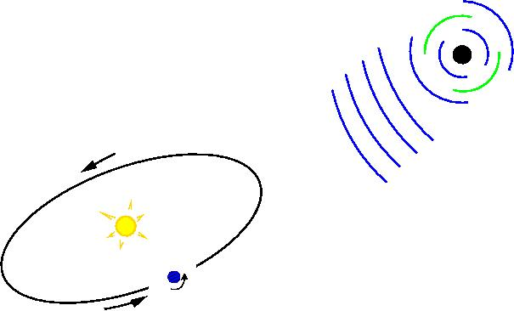
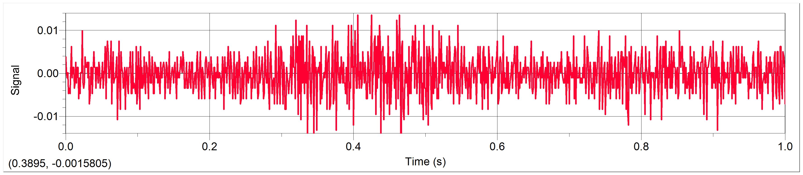
How might GW’s be produced?
The most likely astronomical sources are:
Stochastic background
from the early universe (the Big Bang! Cosmic Strings,…) a “cosmic gravitational wave background”
Continuous Wave sources,
such as spinning (and asymmetric!) or oscillating neutron stars (“gravitational pulsars”).
Coalescence of binary systems,
inspiral of pairs of neutron stars and/or black holes (NS-NS, NS-BH, BH-BH) CHIRP!
Bursts
from supernovae or other cataclysmic events Requires changing quadrupole.
Spherical symmetric → no GW!
or..... something unexpected!

Slide 10
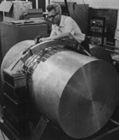
How might GW’s be detected?
Simplest example: the “bar-bell” detector
mm
mm
Pioneered by Joseph Weber at University of Maryland in 1960’s (no detection)
m
m
Practical implementation: a “bar” detector
piezoelectric
detector

Slide 11
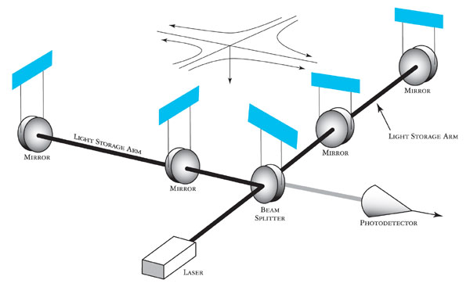
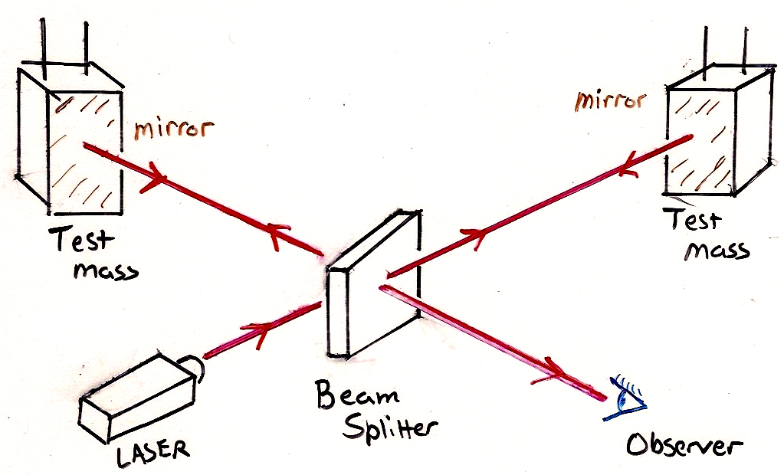
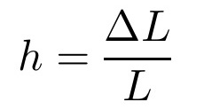
Michelson Interferometer
Pioneered by Rainer Weiss, at MIT and Ron Drever at Glasgow in the 1970's
Measuring ΔL in arms allows the measurement of the strain, which is proportional to the gravitational wave amplitude
(Larger L is better, and multiple reflections increase effective length.)
Notes:
http://www.ligo.org/science/GW-Overview/images/IFO.jpg

Slide 12
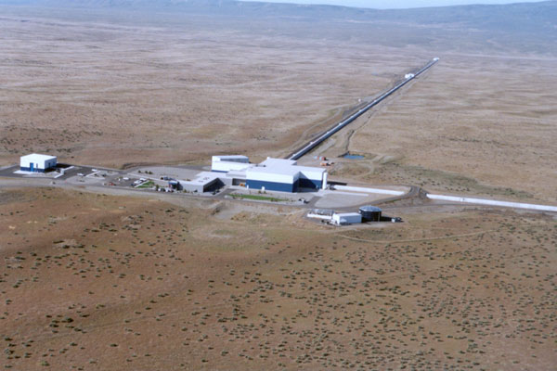
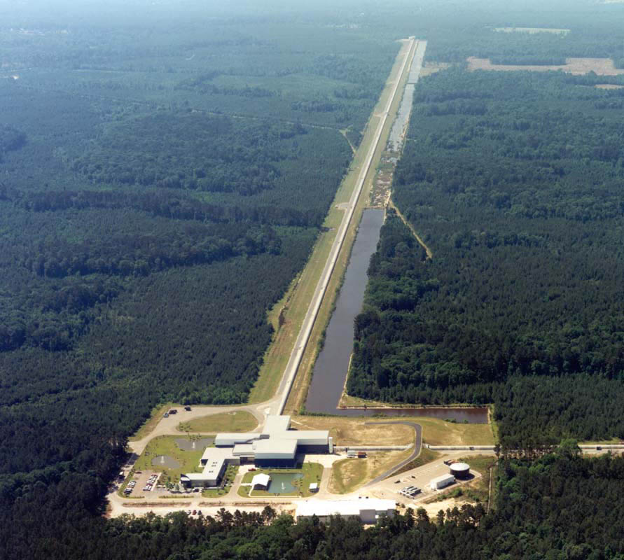
Laser Interferometer Gravitational wave Observatory
LIGO Livingston Observatory (LLO)
Livingston Parish, Louisiana
L1 (4km)
LIGO Hanford Observatory (LHO)
Hanford, Washington
H1 (4km) and H2 (2km)
Funded by the National Science Foundation; operated by Caltech and MIT;
the research focus for ~ 1000 LIGO Scientific Collaboration members worldwide.

Slide 13
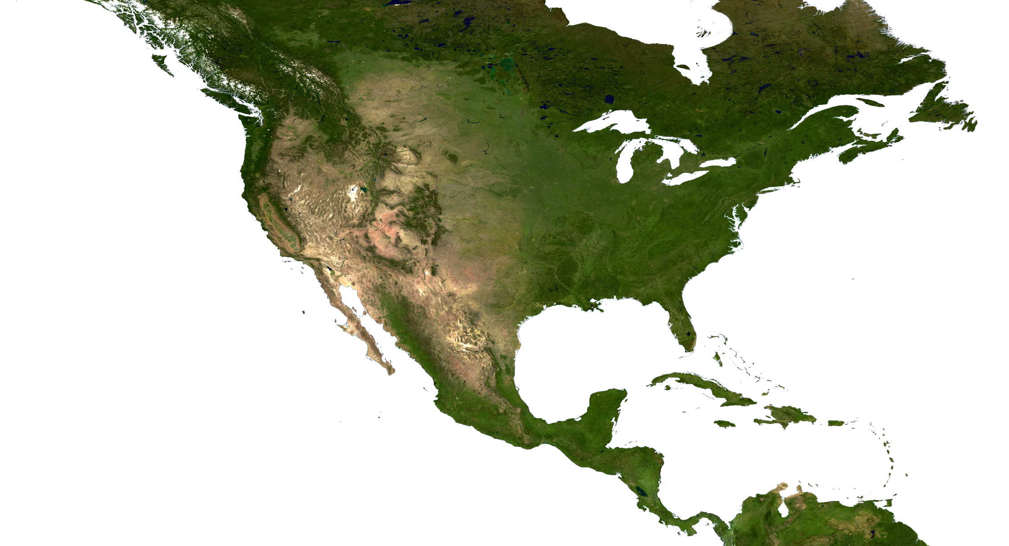

The LIGO Observatories
LIGO Hanford Observatory (LHO)
H1 : 4 km arms
H2 : 2 km arms
10 ms
LIGO Livingston Observatory (LLO)
L1 : 4 km arms
Adapted from “The Blue Marble: Land Surface, Ocean Color and Sea Ice” at visibleearth.nasa.gov
NASA Goddard Space Flight Center Image by Reto Stöckli (land surface, shallow water, clouds). Enhancements by Robert Simmon (ocean color, compositing, 3D globes, animation). Data and technical support: MODIS Land Group; MODIS Science Data Support Team; MODIS Atmosphere Group; MODIS Ocean Group Additional data: USGS EROS Data Center (topography); USGS Terrestrial Remote Sensing Flagstaff Field Center (Antarctica); Defense Meteorological Satellite Program (city lights).
Notes:
I got this slide from Fred Raab, LHO Director

Slide 14
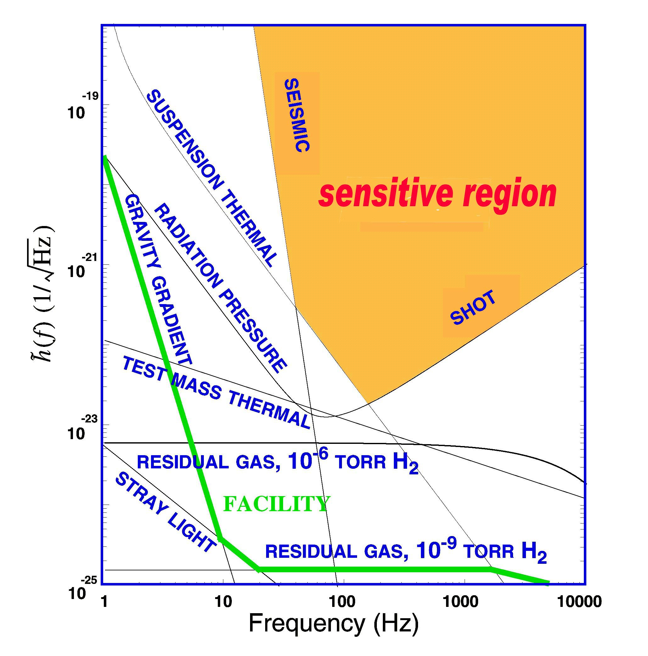
What Limits Sensitivity?
Seismic noise & vibration limit at low frequencies
Atomic vibrations (thermal noise) inside components limit at mid frequencies
Quantum nature of light (shot noise) limits at high frequencies
Myriad details of the lasers, electronics, etc., can make problems above these levels

Slide 15
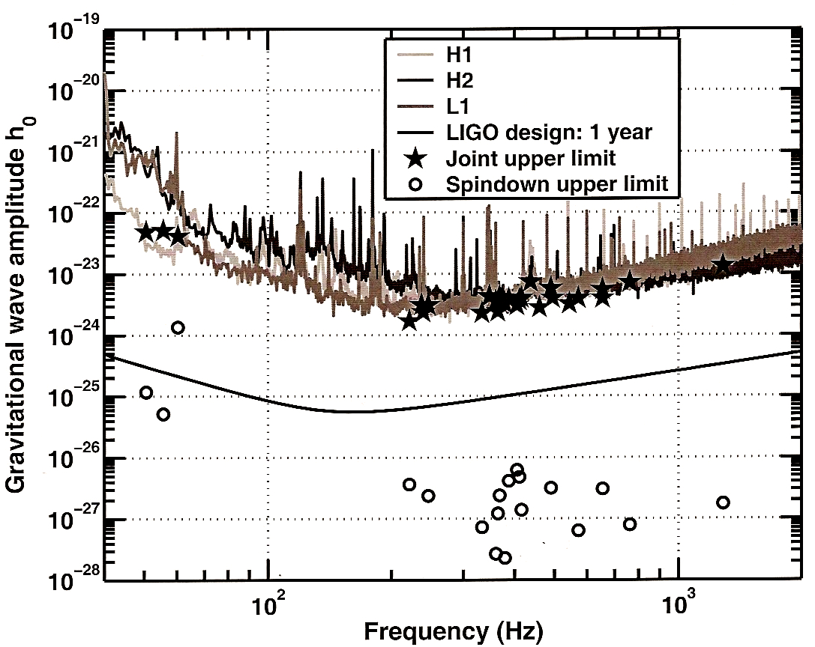
Pulsar Upper Limits (S2)
S2: 14 Feb to 14 April 2003

Slide 16
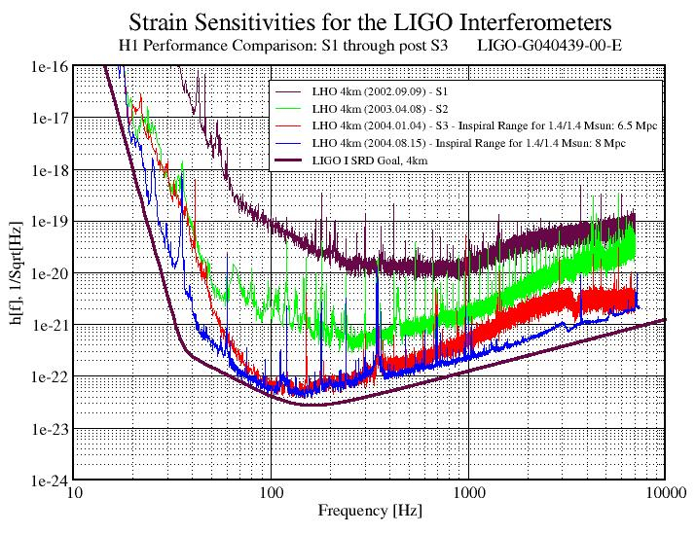
S3 Sensitivity
S3: 31 Oct 2004 to 9 Jan 2005

Slide 17
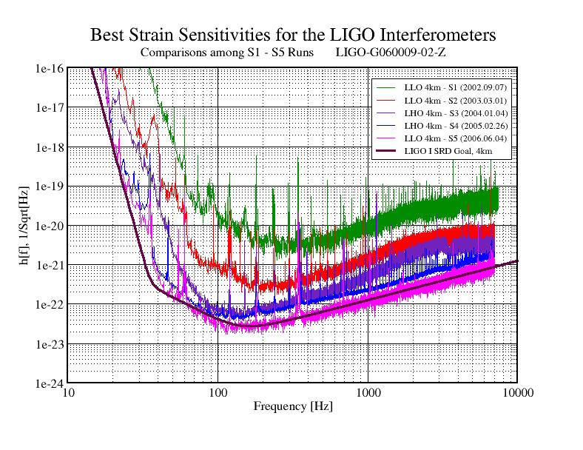
Strain Sensitivity S1 - S5
S5: 4 Nov 2005 to 30 Sept 2007

Slide 18
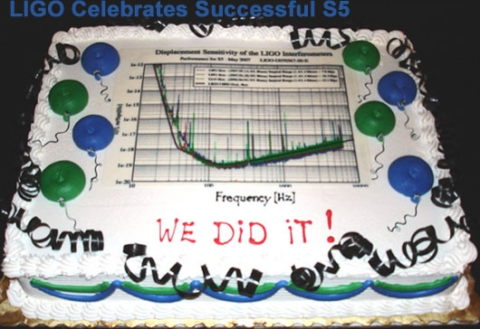
Challenge of the NSB
National Science Board Resolution (2005):
"The Board approved the resolution [supporting funding for Advanced LIGO] with the understanding that the existing LIGO Program will collect at least a year's data of coincident operating at the science goal sensitivity before initiating facility upgrades to the new Advanced LIGO technology."
Source: B. Berger, "View from the NSF", G050339-00
S6 run started with "Enhanced LIGO" in mid 2009, with ×2 sensitivity
Advanced LIGO began taking data in 2015, with ×10 sensitivity.
S5 completed successfully 30 Sept 2007!
Proceeded to upgrade to "Enhanced LIGO"

Slide 19
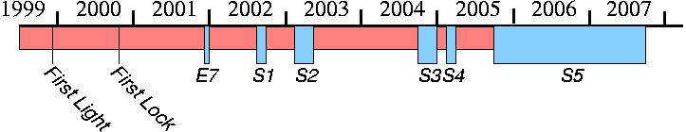
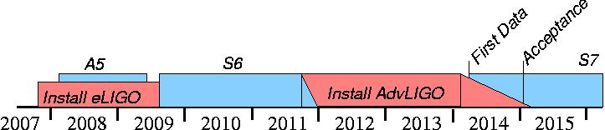
LIGO Timelines
Enhanced LIGO and Advanced LIGO approved in principle by NSB in 2005.
Construction began 1995
Advanced LIGO began
taking data Sept. 2015
O1

Slide 20


Initial LIGO
Enhanced LIGO
Advanced LIGO
Construction: 1995 - 2002 2007 - 2009 2011 - 2015
Data Collection: 2002 - 2007 2009- 2010 2015 -
Laser Power: 10 W 30-35 W 200 W
Output mode cleaner: NO YES YES
In-vacuum readout HW: NO YES YES
Active Seismic Isolation: LHO: NO LHO: NO LHO: YES
LLO: NO LLO: YES LLO: YES
Seismic cutoff freq: 40 Hz 40 Hz / 10 Hz 10 Hz
Data Channels: 12,733 ~ 10,000 ~ 300,000
Strain Sensitivity (@100Hz): 3 × 10⁻²² ~ 1.5 × 10⁻²² 3 × 10⁻²³
Relative Sensitivity: × 1 × 2 × 3 to 5 (eventually ×10)
Maximum Reach: 10 Mpc 20 Mpc 40-80 Mpc
(eventually 200 Mpc)
Cost: 420 M$ add 2.04 M$ 620 M$ (add 200 M$)
Notes:
https://www.advancedligo.mit.edu/daq.html
LIGO-T060156-01-I and LIGO– T060091-00-I

Slide 21
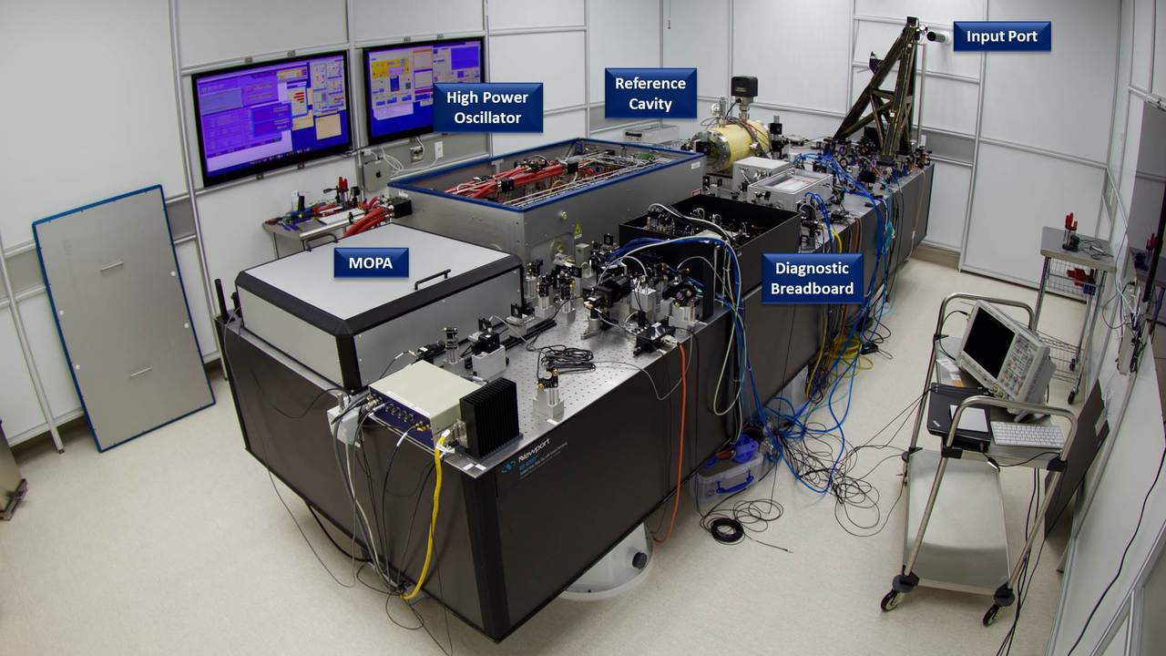
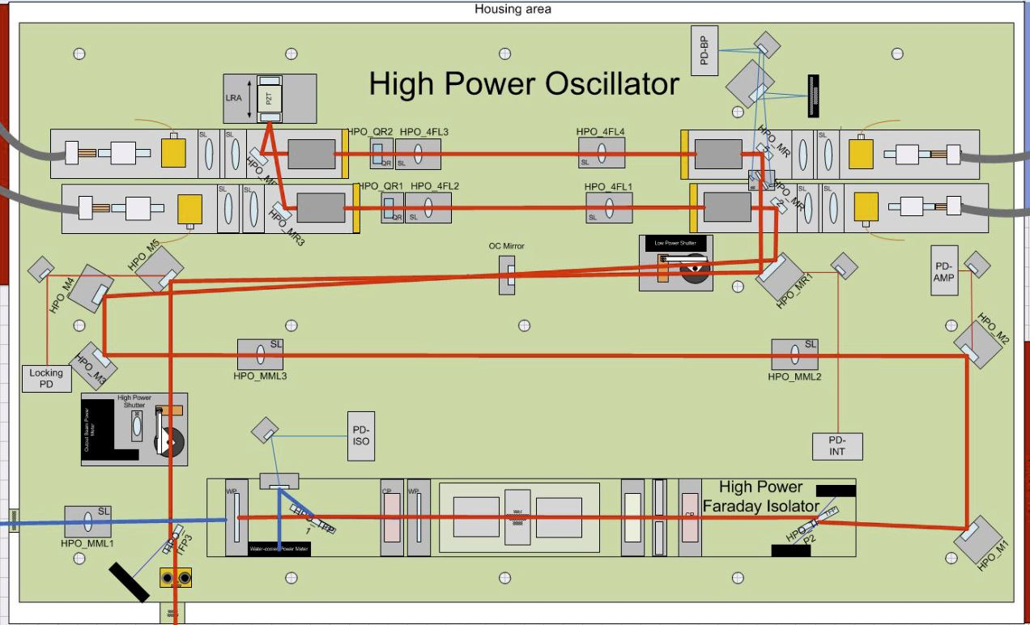
LIGO Lasers
Laser diode
(4W @ 808 nm)
⬇
Garnet Crystal
(2W @ 1064 nm)
⬇
Laser Amplifier Rods x 4
(35 W @ 1064 nm)
⬇
High Power Oscillator (HPO)
(7 x 45 W @1064 nm)
⬇
16kHz Feedback Control
(200 W @ 1064 nm)
⬇
Interferometer
https://www.ligo.caltech.edu/page/laser
Notes:
https://www.ligo.caltech.edu/page/laser

Slide 22
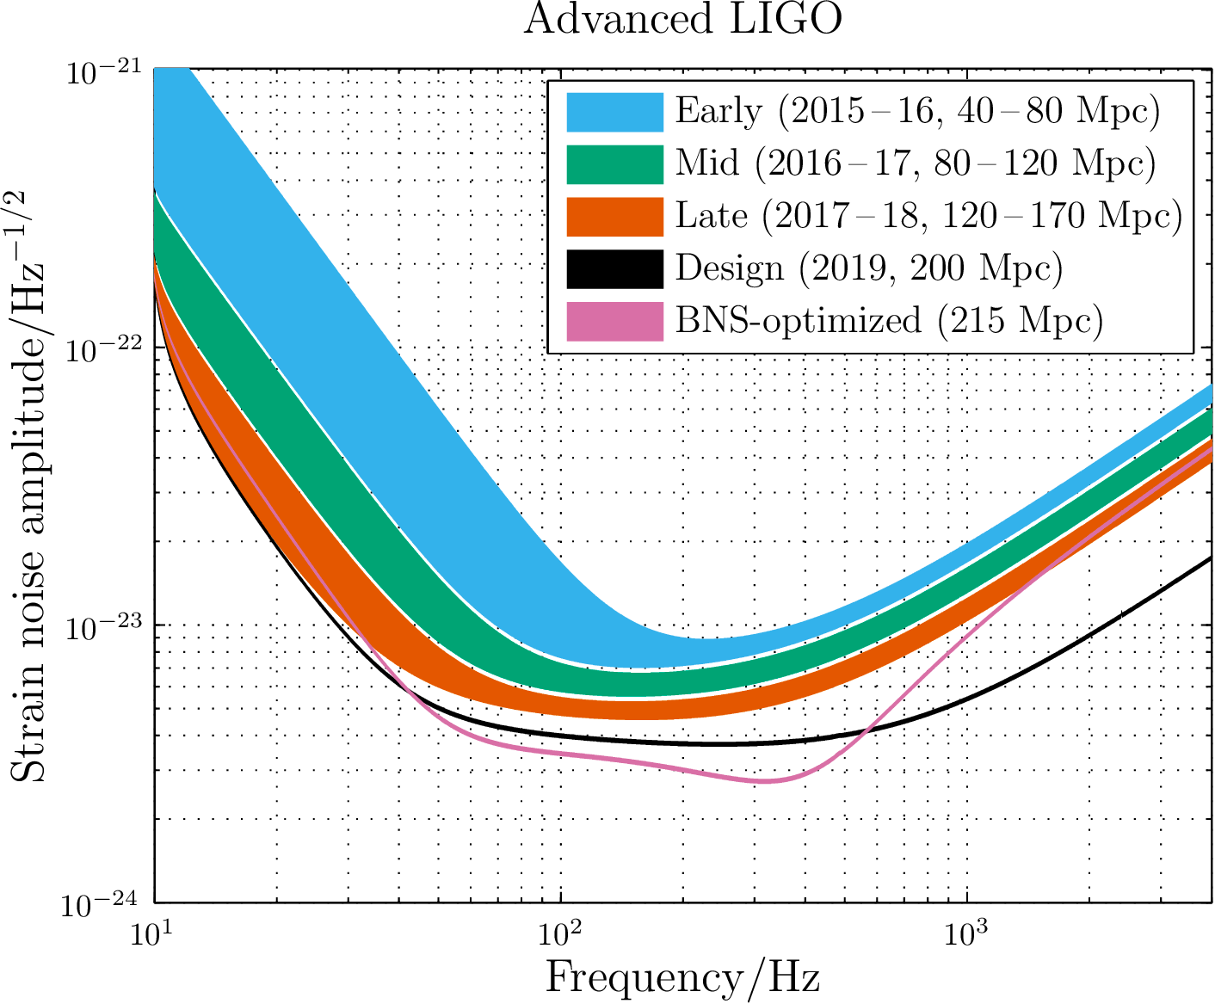
Source: ArXiv: 1304.0670v2.pdf

Slide 23
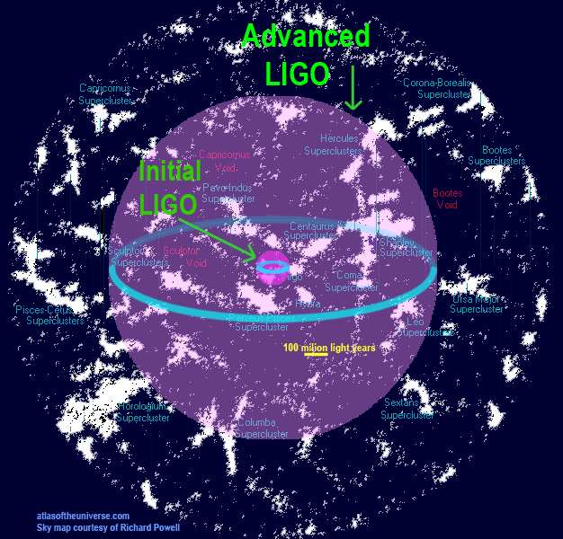
Notes:
https://www.advancedligo.mit.edu/overview.html
https://www.advancedligo.mit.edu/graphics/aLIGO-reach-2.gif

Slide 24
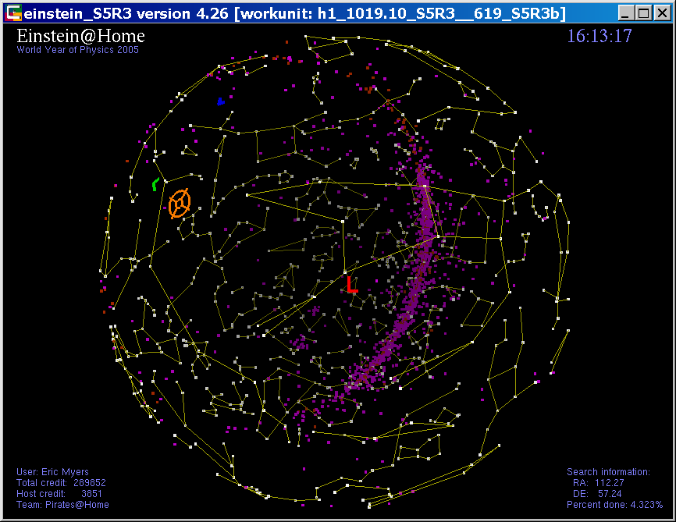
Einstein@Home

Slide 25
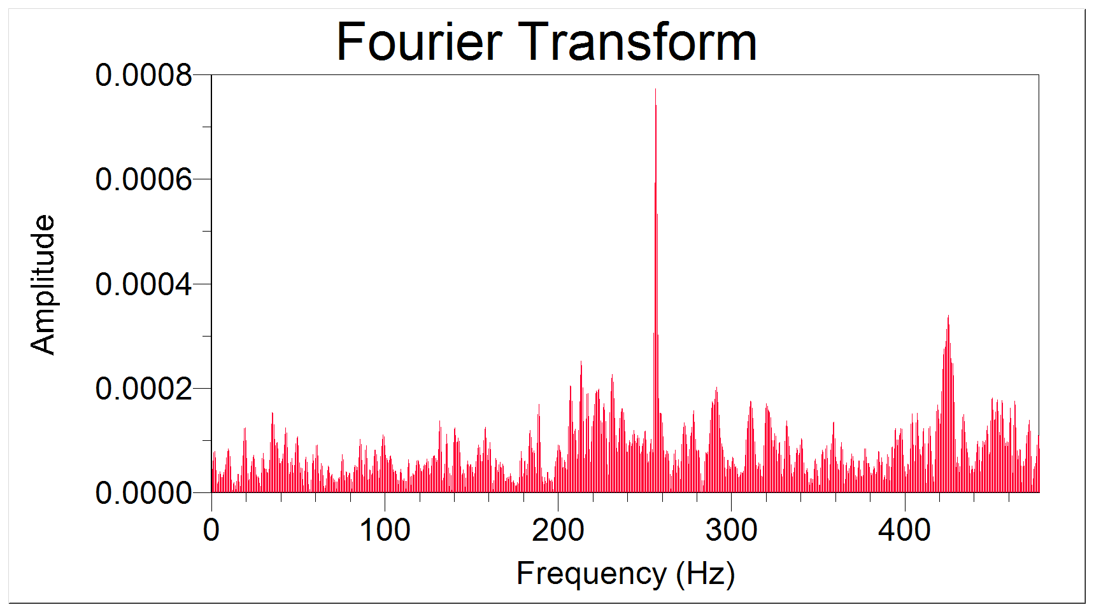
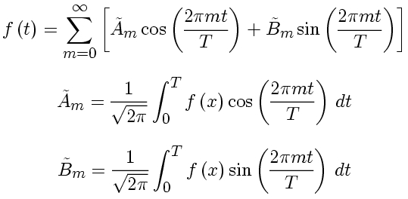
How to search for CW signals?
If the frequency of the signal is constant, then searching for a signal is easy.
Starting with Signal + Noise . . .
“time-series”
t
Take the Fourier Transform to obtain:
There is even a computationally fast algorithm for this, the Fast Fourier Transform (FFT).

Slide 26
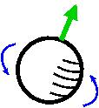
But the frequency will change!
The frequency is not expected to be constant,
due to:
The source losing energy due to "spin down"
Doppler shift due to Earth's motion about the Sun (one part in 10⁴, with period of 1 year)
Doppler shift due to Earth's rotation about its axis (one part in 10⁶, with period 1 sidereal day)
Exact form of the modulations depends upon the sky location of the source!

Slide 27
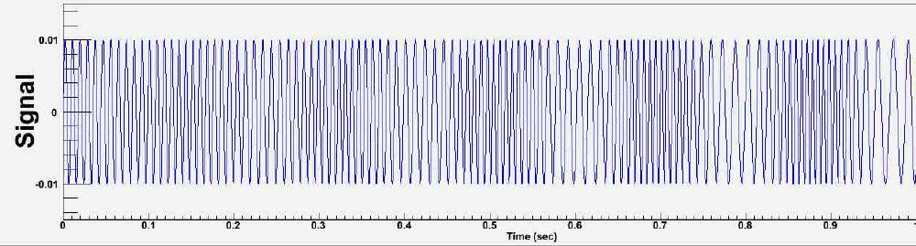


Matched Filtering
data
"template"
Assuming data
compute
In reality h(t) is more complex, and depends on sky position, frequency, spin-down, and signal phase!
"the F statistic"
And computational effort goes up like T⁶ !
Looks like we're gonna need a bigger computer!
Notes:
Denominator is strength of the noise. The larger the noise, the weaker the signal.

Slide 28

BOINC to the rescue
SETI@home is a distributed computing project searching for distinctive peaks in Arecibo radio data. In 2004 they upgraded to BOINC:
Berkeley
Open
Infrastructure for
Network
Computing
BOINC is modular, so that one can replace the
"computation thread" and the "graphics thread".
So we did. → Einstein@Home

Slide 29
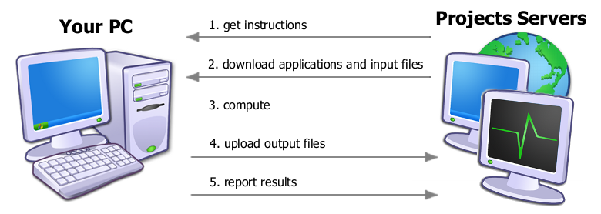
Einstein@Home
How to use BOINC to search for a CW signal:
Break the computations up into smaller "workunits"
Send these workunits (WU's) to participating "clients"
Each WU searches the entire sky (~30,000 points!) for a narrow band of frequencies and the full range of spin-downs, computing the F-statistic.
Client returns top 13,000 candidates to the server for further processing, and receives new WU's.

Slide 30
Screensaver graphics
LHO azimuth position
LLO azimuth
position
Search marker
GEO600 azimuth
position
Known pulsars
(electromagnetic)
and SNR's
User, team, host info

Slide 31
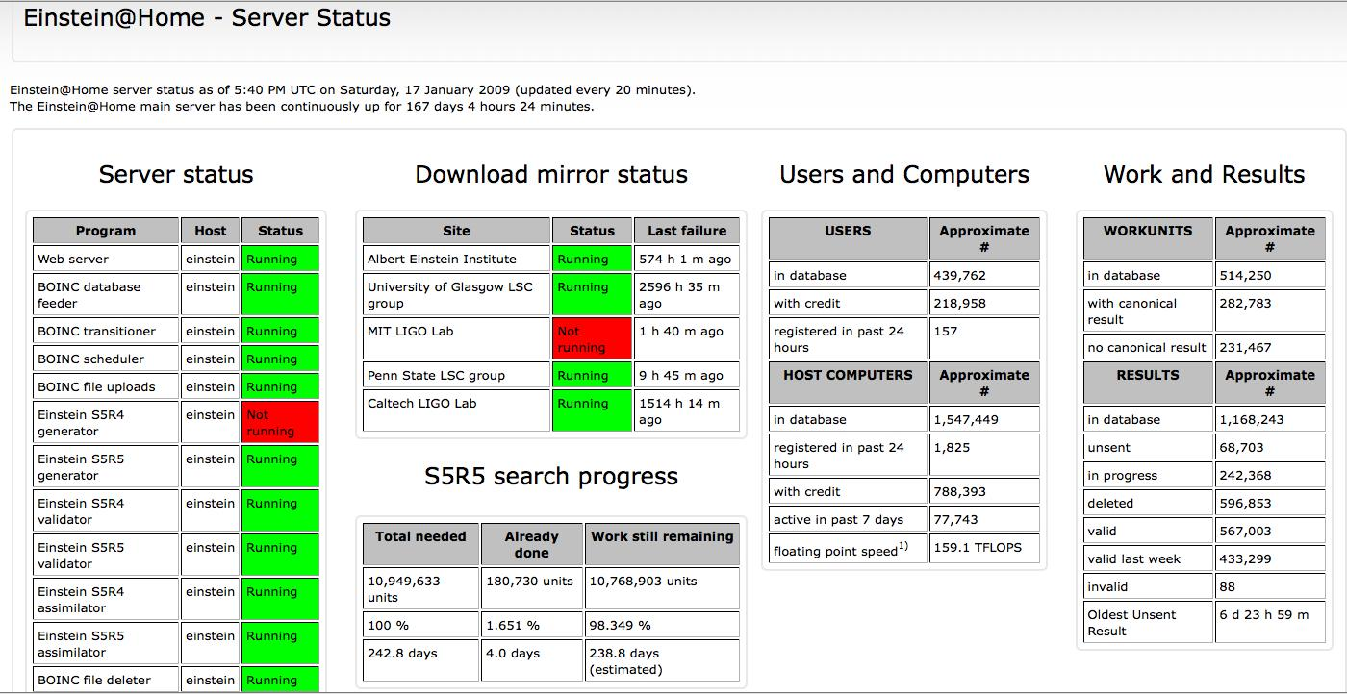
Einstein@Home status
As of 17 January 2009
Values are doubled by 2016
Notes:
As of 26 March 2016:
Users with credit: 427,775 (x2)
Computers with credit: 1,495,481 (x2)
Floating point speed: 2111.7 TFLOPS (x13 improvement)

Slide 32
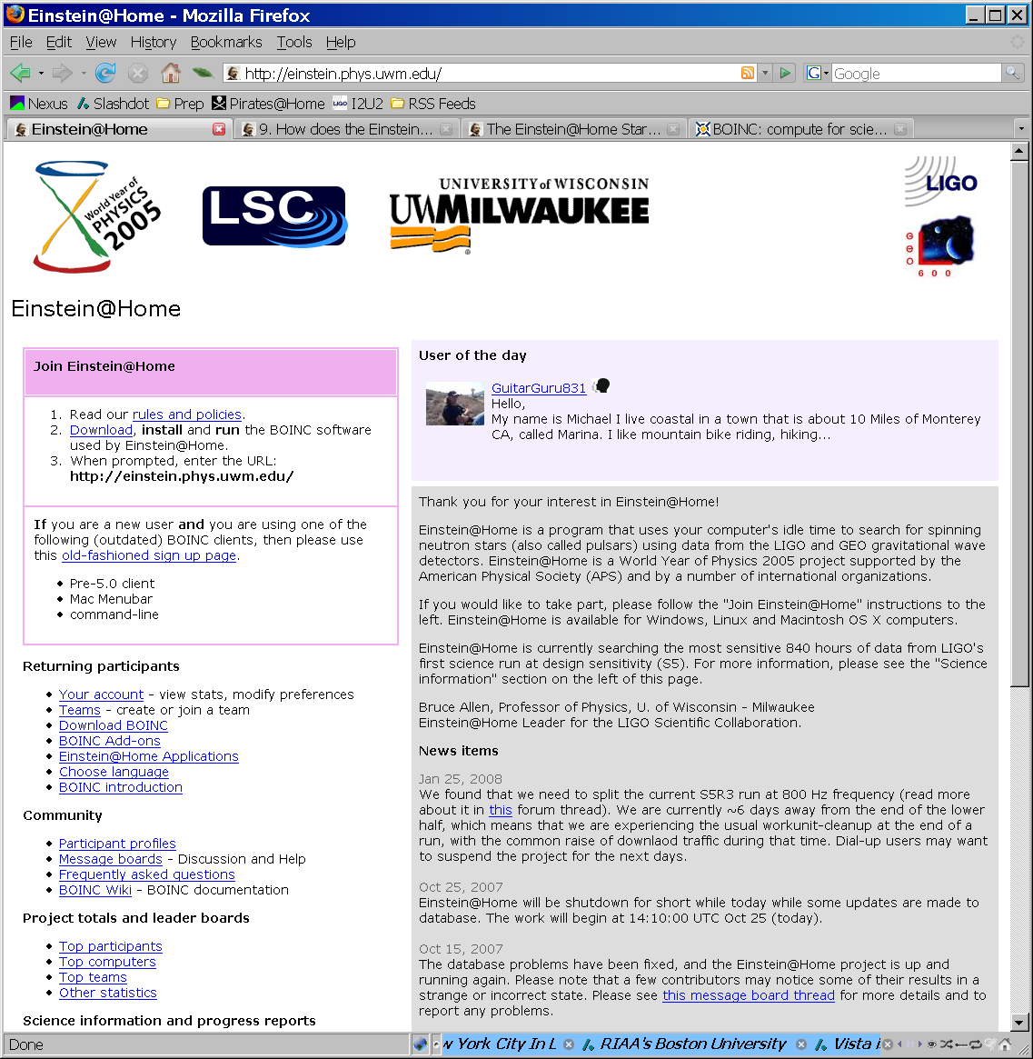
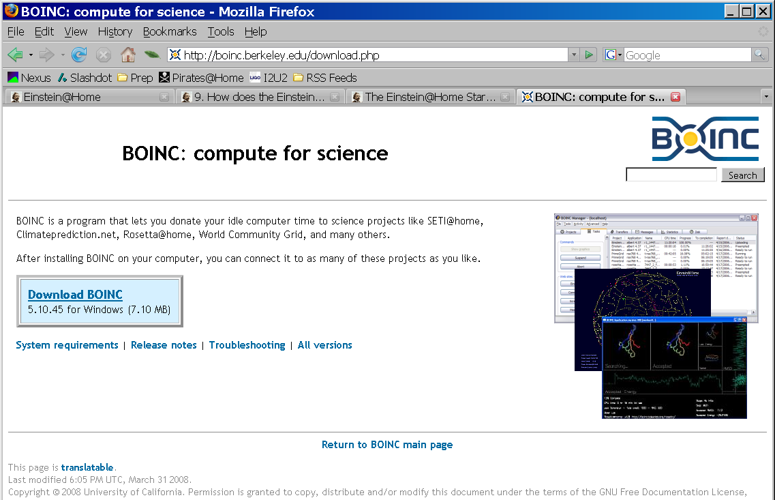
How you can join
Visit project web site at
http:/einstein.phys.uwm.edu
Follow download link to BOINC site at UC Berkeley
Download BOINC package
Double click package to install, follow directions
"Attach" to Einstein@Home

Slide 33
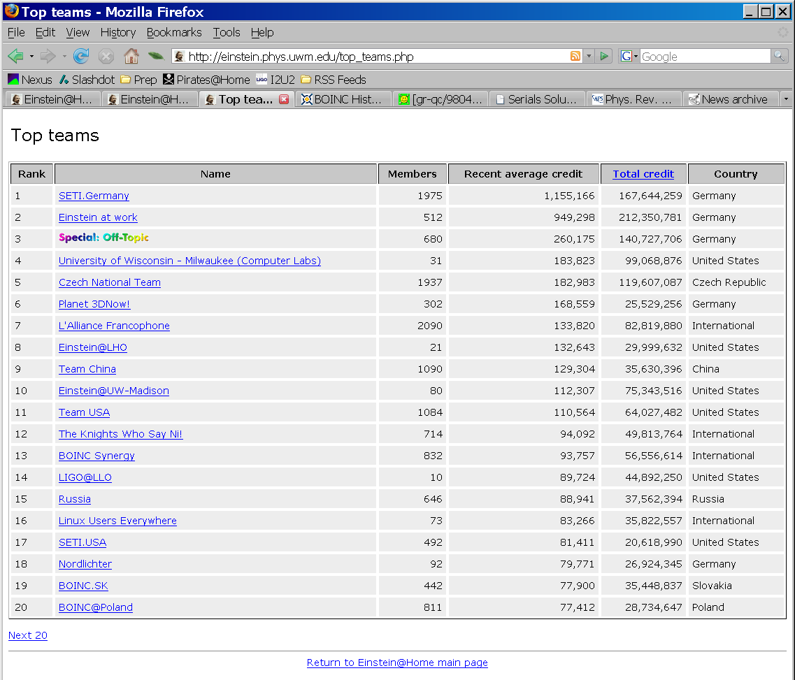
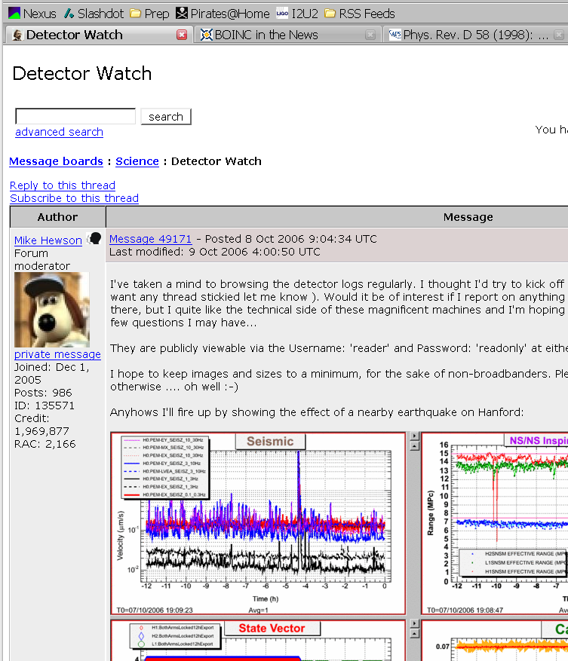
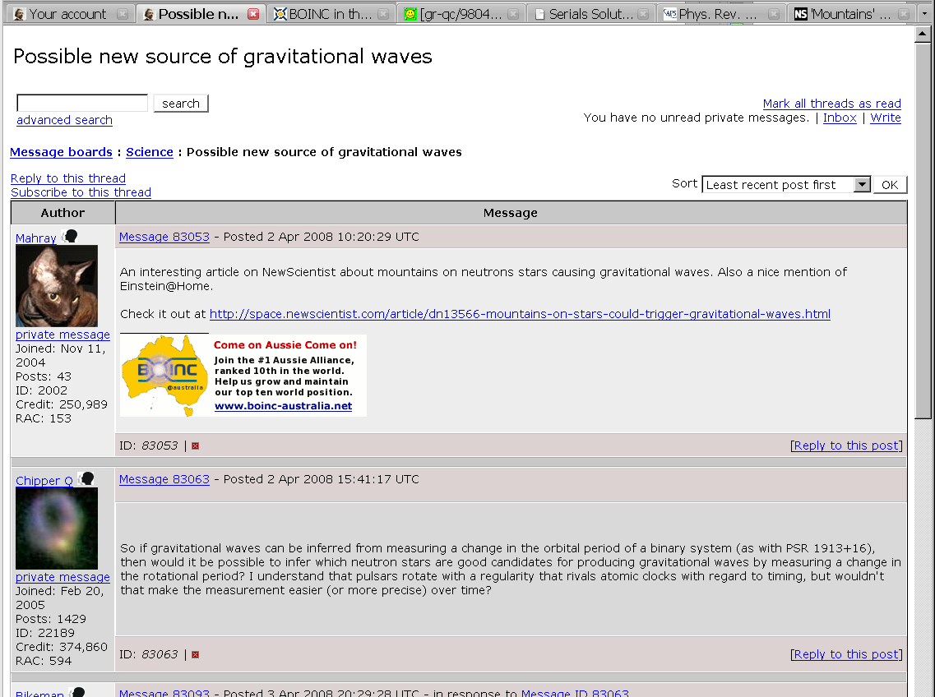
Join others: Teams and Forums

Slide 34
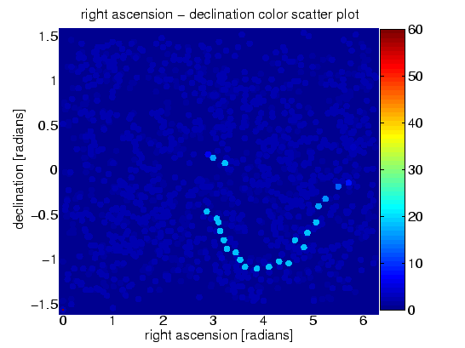
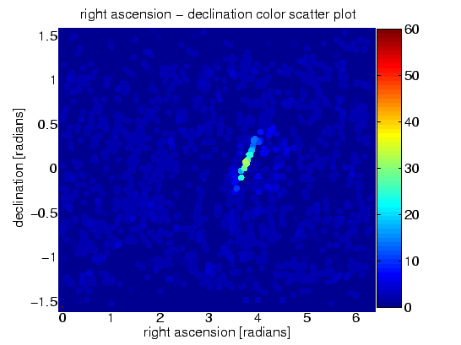
Einstein@Home results
No detections! (except injections)
S3 final analysis is described on the project website: See http://einstein.phys.uwm.edu/FinalS3Results
S4 analysis is described in a paper:
S3 Hardware injection (1 of 11)
“The Einstein@Home search for periodic gravitational waves in LIGO S4 data”
by the LIGO Scientific Collaboration
Physical Review D, 79, 022001 (January, 2009)
S3 Software injection (1 of 6)
S5 analysis:
“Einstein@Home search for periodic gravitational
waves in early S5 LIGO data”
by the LIGO Scientific Collaboration
Physical Review D, 80, 042003 (August 2009)
Notes:
UPDATE THIS FOR 2016

Slide 35

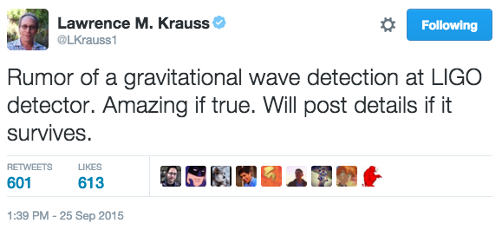
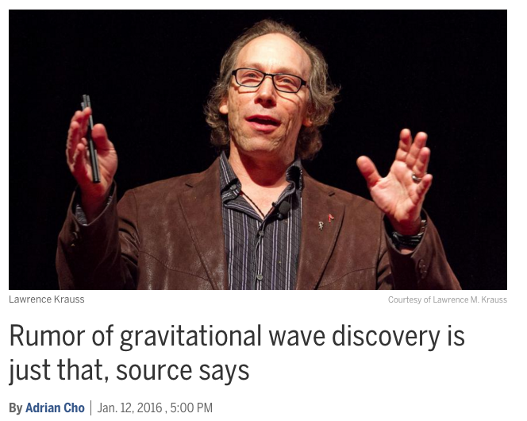
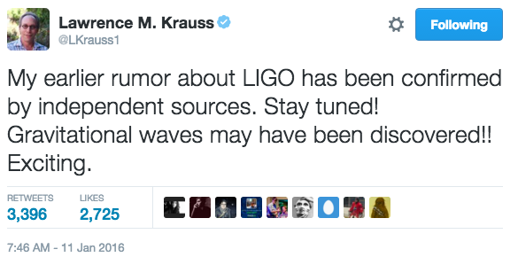
Has LIGO made a detection?
"LIGO researchers thought they had discovered a signal on 16 September 2010, just before they shut down for the rebuild. But it turned out to be an injected signal, which the researchers found out only as they were about to submit for publication a paper claiming a discovery."
Notes:
http://www.sciencemag.org/news/2016/01/rumor-gravitational-wave-discovery-just-source-says
https://www.newscientist.com/article/dn28754-new-rumours-that-gravitational-waves-have-finally-been-detected/

Slide 36
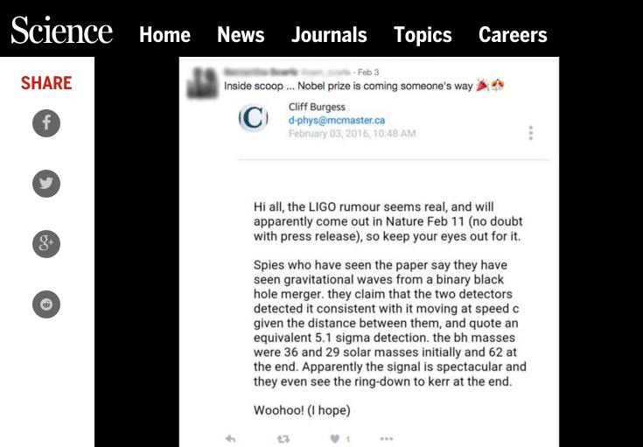
Notes:
http://www.sciencemag.org/news/2016/02/woohoo-email-stokes-rumor-gravitational-waves-have-been-spotted

Slide 37
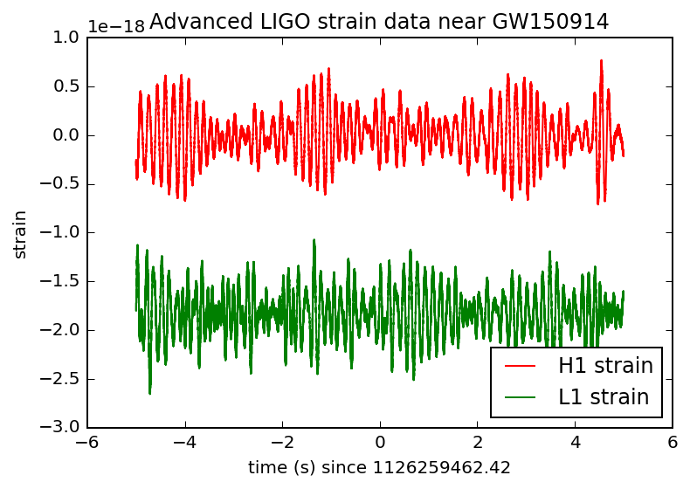
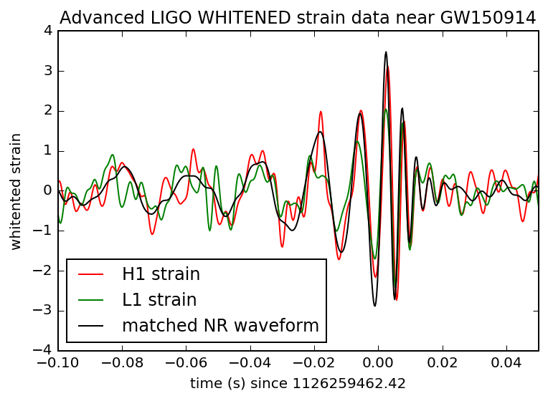
Matched Filtering for Binary Inspiral
The same method of Matched Filtering can be used to search for binary inspiral, by using different template functions.
Raw strain data
Template with bandwidth filtered strain data.
Notes:
https://losc.ligo.org/s/events/GW150914/GW150914_tutorial.html

Slide 38


What is the sound of two black holes colliding?
Gravitational waves are not sound waves, but the frequencies can be comparable to the audio range, so we can listen to them.
http://www.ligo.org/science/GW-Inspiral.php
LISTEN TO IT!
Binary neutron stars, 1.5 solar masses each
Binary black holes, 50 solar masses each
http://gmunu.mit.edu/sounds/comparable_sounds/comparable_sounds.html
Image Source: New Scientist
Notes:
http://gmunu.mit.edu/sounds/comparable_sounds/comparable_sounds.html
http://www.ligo.org/science/GW-Inspiral.php

Slide 39

Success! Event GW150914
(Advanced LIGO had only been on-line for about 2 days!)

Slide 40

Abbot, et. al., Phys. Rev. Letters 116, 061102 (2016) – Figure 3
Notes:
Abbot, et. al., Phys. Rev. Letters 116, 061102 (2016) – Figure 3

Slide 41

First Detection
GW150914, recorded at 09:50:45 UTC on 14 Sept 2015
LISTEN TO IT!

Slide 42

Event GW150914
Physical Review Letters 116, 061102 (2016) - Figure 1
Notes:
Physical Review Letters 116, 061102 (2016) - Figure 1

Slide 43
Gravitational Waves Take-away
Gravitational waves travel at the speed of light.
Gravitational waves are produced at twice the frequency of the binary
Gravitational waves are quadrupole distortions of space-time
Gravitational wave amplitude is measured by strain h = ∆L/L
Gravitational wave amplitude decreases with distance like 1/r
For binary inspiral the signal increases in both frequency and amplitude: CHIRP!
Expect even more sources (eg. white dwarf binaries) at lower frequencies.
LIGO reach for 1.4 M☉ × 1.4 M☉ binaries is now about 30 Mpc, and expected to reach 200 Mpc by 2019.

Slide 44
LIGO Results for GW150914
Physical Review Letters 116, 061102 (2016)
First detection of gravitational waves
First observation of binary black hole merger
No evidence for violations of general relativity
Improved bound on gravition mass: m_{g} < 1.2 × 10⁻²⁷ eV/c²
Demonstrates the existence of stellar mass black holes with mass more than 25M⊙
Establishes that binary black holes can form in nature and merge within a Hubble time.
Constrains rate of stellar-mass black hole mergers in the the local universe

Slide 45
What's next?

Slide 46

LIGO - India
"We have built an exact copy of that instrument that can be used in the LIGO-India Observatory," says David Shoemaker, leader of the Advanced LIGO Project and director of the MIT LIGO Lab, "ensuring that the new detector can both quickly come up to speed and match the U.S. detector performance."
Image © Tarun Souradeep, from http://www.natureasia.com/en/nindia/article/10.1038/nindia.2016.20
Notes:
http://www.astronomy.com/news/2016/02/ligo-india-gets-the-green-light

Slide 47

eLISA
eLISA
(evolved) Laser Interferometer Space Antenna
The eLISA mission consists of one “Mother” and two “Daughter” spacecraft orbiting the Sun in a triangular configuration, connected by the two arms of a laser interferometer.
The formation trails Earth in its orbit by 20° and the plane of the triangle is 60° from the plane of the ecliptic.
Notes:
https://www.elisascience.org/

Slide 48

LISA Pathfinder
LISA Pathfinder is now in a Lissajous orbit around L1.
3 DEC 2015 Launched
22 JAN 2016 Arrived at Lagrange point L1
16 FEB 2016 Test masses released
8 MAR 2016 Began science mode
Image: Copyright ESA/C.Carreau
Notes:
https://www.elisascience.org/articles/elisa-mission/mission-concept
https://www.elisascience.org/

Slide 49
Pop Quiz!
Explain the meaning of these equations:
1.
3.
4.
2.
5.
Explain the meaning of these graphs:

